Slide 1
Lecture 17 – Assembly language
2017.09.29
The three most terrifying words to parents of a young child very late the day before a major gift-giving event?
“Some assembly required.”
The second most? “Batteries not included.”

Slide 2
Assignment for 2017.09.29
Reading textbook chapters 7 and 9
HW05 due Thursday, Oct. 05

Slide 3
Announcements
Lab 06 will issue after October Break

Slide 4
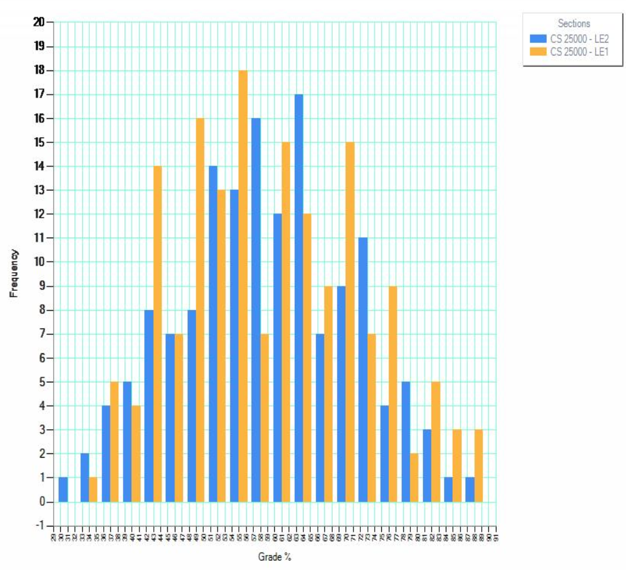
Midterm 1 data
High 91
Low 31
Mean 59.5
Median 58
StdDev 12.3
Q15 version A: no answer was correct due to a typographical error, all answers earned 3 points

Slide 5
A software hierarchy
High-level languages featuring strong abstraction from the details of the computer; portable; programmer productivity
_{Java, Pascal, FORTRAN, etc.}
_{C (high-level assembly)}
_{X86}
_{MIPS}
_{ARM}
_{VAX}
…
…
_{32- & 64-bit strings}
_{32- & 64-bit strings}
_{Variable length bit strings}
_{Variable length bit strings}
Portable among different computers with some effort; some machine-dependent features are visible; performance
Assembly languages: a distinct one for each computer, hardware dependence, just a few abstractions
Machine languages: one per computer; NO abstractions

Slide 6
Assembly language
“assembly language” refers to any such, and they are all (somewhat) different
Many assembly languages share the same fundamental structure; Why?
Typical assembly language statement syntax and corresponding machine code in 0x label: op result, operand1, operand2 0x004005F9 0x23CC803C
Label is symbolic (an abstraction) for a memory address; “op” is a mnemonic for the operation
Notes:
Use Thought question #7

Slide 7
Assembly and opcodes
Set of opcode-field bit strings defines what the processor circuit can do
Different processors have different sets of opcodes
Assembly language defines a memorable symbolic name of a few characters for each opcode, a mnemonic
No agreement on opcode mnemonics across assembly languages

Slide 8
Assembly and comments
Assembly is easy to write but hard to follow
Comments are essential
Block comment – explain the purpose of a section of code and detail the use of registers and memory
Line comment – explains each instruction
Usually a comment starts with a delimiter and then runs to the end of the line
Best strategy: comment every line

Slide 9
Example comments
######################################### # Search linked list of free memory blocks to find # # a block of size N bytes or greater. Pointer must #
# be in r3 and N in r4. Code destroys contents of #
# r5, which is used to walk the list. #
########################################## ld r5,r3 # load address of list into r5
loop_1: cmp r5,0 # test to see if at list end
bz notfnd # if reached end go to notfnd

Slide 10
Assembly language specifics
Read documentation to learn
Operand order
How registers are named
How constants are represented
How to indicate an immediate value, a value in a register, and a value in a memory location
Assembly language does not provide program control structures, such as if, while, call
Assembly enforces no coding style

Slide 11
Program structure and default fetch
A machine instruction (instr.) is fetched at
Default-computed next instruction address (for straight line code), or at
Differently-computed next instruction address (for program structures, if(e){ }, while(e){ }, ...)
To have program structure in assembly, must use instructions that override the default computation of next instruction adress

Slide 12
Building program structure in assembly
Abbreviate Current_instr._pointer as PC, for program counter
Assume fixed size instructions
Default_next_instr._fetch is at PC+sizeof(instr.)
Thus, to have program structures requires a condition to control when to perform a Non-default_next_instr._fetch which is a fetch at PC + Offset
Notes:
Here is a big use for the Offset field. Other big use is for accessing elements of arrays. You could say “A program is an array of type instruction (plus any initialized data).”

Slide 13
Machine code to override “default next”
Circuit inputs cannot be abstract, thus
Every bit of each machine code instruction must be known before execution
To override default next instruction address computation by using PC+Offset
Assembler computes Offset value such that
PC+Offset will point to the target instruction
Programmer includes a (conditional) branch-to-target instruction that executes
if (condition) { PC + Offset } else { PC + sizeof(instr.) }
Notes:
Here is a big use for the Offset field. Other big use is for accessing elements of arrays. You could say “A program is an array of type instruction (plus any initialized data).”

Slide 14
Labels in assembly language
Label is an assembly language symbolic name for the memory address of an instruction
Labels tell the assembler to figure out the address of the labeled instructions
Use a label when you want an assembly instruction to be a branch target
Labels allow the assembler to compute the difference (Offset) between the memory address of a branch instr. and its target instr. so that the programmer does not have to

Slide 15
Assembly is two-pass, to compute Offsets
Many Offset values are positive
If-then-else skips ahead in a program: skip ahead to else when condition=false, or execute then and skip over else
Instructions ahead in a program are located at higher-numbered memory addresses (addr.)
First pass of assembler eventually determines memory addresses of all labels, even those that are forward references, recording progress in the symbol table
Second pass emits machine code bit strings by
translating op mnemonics, register names, etc. into bit fields
using symbol table to fill in the offset bit field using formula Offset = Branch_target_addr. – Branch_instr._addr.
Notes:
Symbol table could have been called the lable table; perhaps early CS people thought that sounded too silly.
CS is Computer SCIENCE, not Computer Silliness.

Slide 16
Other good reasons why assembly is 2-pass
Without labels, looking for program structure in assembly would require mentally solving Branch_target_addr. = Branch_instr._addr.+Offset to find branch target instructions
Without labels, if you edit assembly code to add/remove instruction(s) between a branch and its target, the correct Offset value changes
Without labels, forget to update all affected offsets, or make a math error when updating, and program structure becomes broken

Slide 17
Aside, why is compiler just 1-pass?
Two-pass means forward references are no problem: all references will resolve eventually
We would not have to declare variables, define functions before using them, just eventually declare and define
However, compilation is often time consuming, even for 1 pass and declaring and defining first is more human readable than, and not much harder than, declaring/defining at random points in code
So, as a design choice, require declare/define first: Win/Win for code readability/compile speed

Slide 18
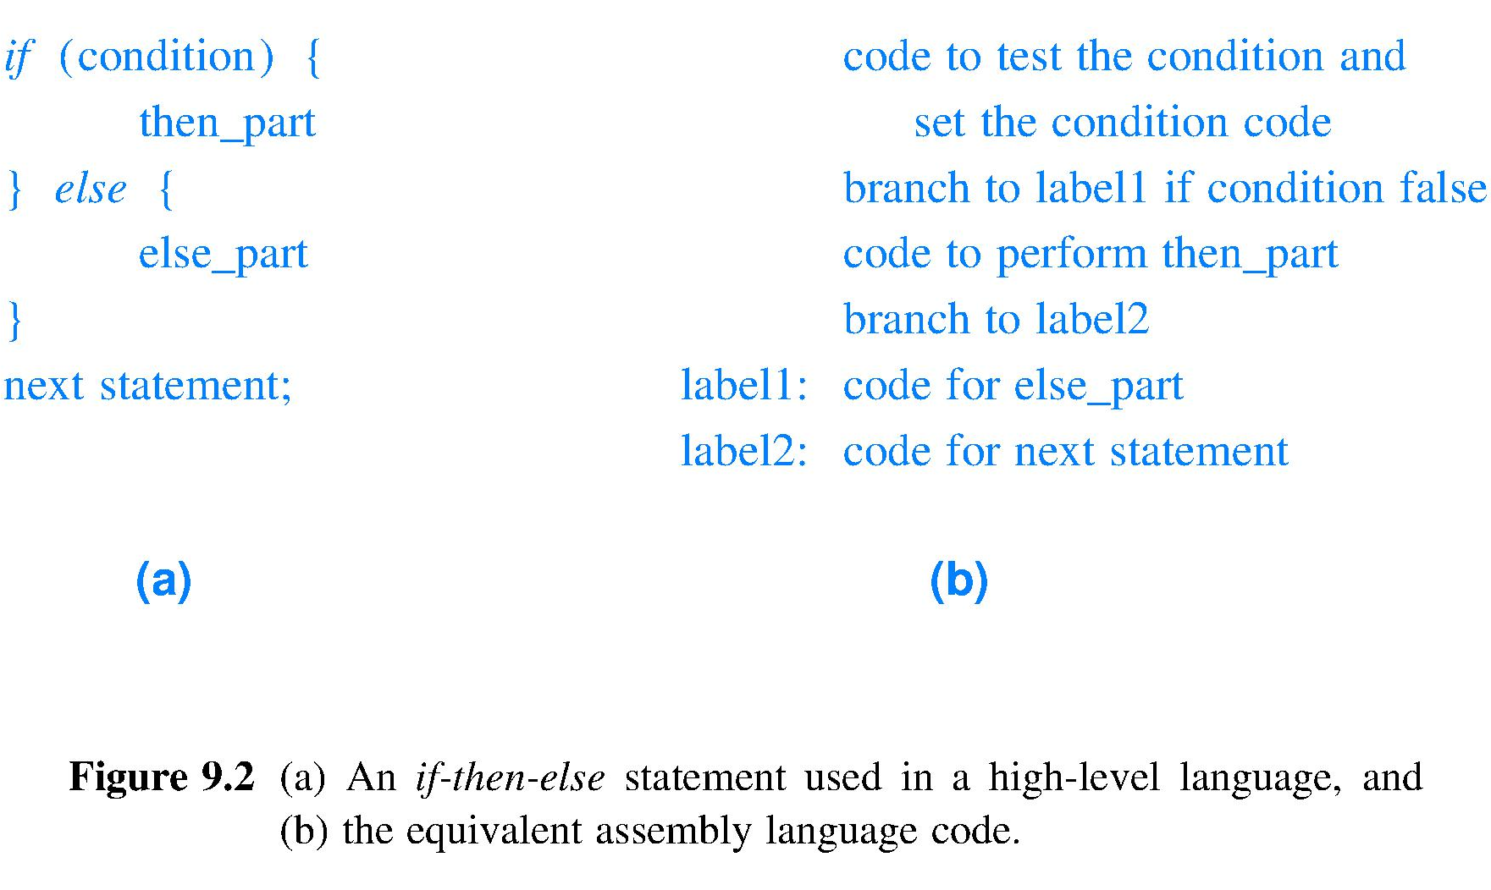
Coding IF-THEN-ELSE in assembly
Create else part →
Forward reference to label1
Do not fall through to else part →
Symbolic else → part start
Fall through beyond else →
“Fall through” means to fetch at the default next instruction location; must code two exceptions for if-then-else

Slide 19
Lecture 19 – Assembly language (cont.)
2017.10.04 Verbing weirds language.
– Bill Watterson

Slide 20
Structure coding practice for assembly
See text Figs. 9.3 and 9.4 for for and while coding prototypes; generalize Fig. 9.2 if-then-else to switch on your own
For productivity and readability it is good practice to code every one of these structures the same way in your assembly, both instruction sequences and comments
A template to copy/paste can be helpful

Slide 21
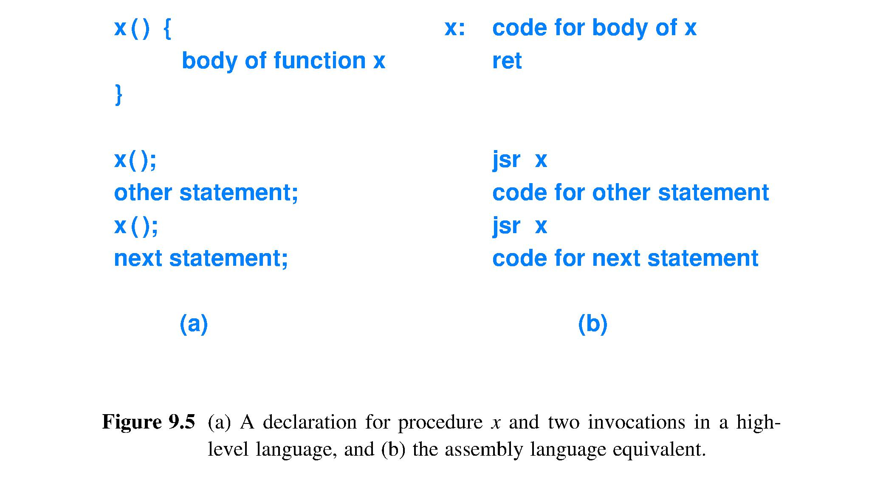
Subroutine call in assembly
Instruction to pop the saved current_instruction_pointer from the stack and override default_next_instruction
Subroutine name becomes, in assembly, just a label, a symbol for the address of the first instruction of the subroutine
Call x();
Instruction to push the current_instruction_pointer onto the stack and override default_next_instruction computation
Notes:
NOTE: Assembler does not require defining x() before calling it.
The subroutine name is the subroutine starting address. A name is a pointer.

Slide 22
Machine code may be position dependent
Assembly ; Comments jump 60(r7) ; Fetch next instr. at offset(reg_A)
Machine code with assembly fields color-coded 00100011110011001000000000111100
r7 is a specific value at the time jump is executed, thus
jump directs next instr. fetch to specific address r7 + 60
If machine code is re-loaded into memory starting at a new, different address then the instr. located at r7 + 60 will not be the one intended
Machine code functionality is position (in memory) dependent when absolute memory addresses are used
Position-dependent machine code can have its absolute addresses adjusted so that references remain correct when the code is relocated by using a relocation table

Slide 23
Passing arguments to subroutines
Details of passing arguments in assembly vary
Ways to pass arguments include
Use the stack in memory
Use register windows
Use special-purpose argument registers
No one design dominates
Optimizing performance is influential
Designers will adapt their argument passing strategy to make good use of current technology

Slide 24
Combining HLL and assembly
Most common case is a high-level language (HLL) program calling an assembly language procedure when the better performance of the procedure, written in assembly, is key
Also, can have assembly call HLL
Assembly code must follow the calling conventions of the HLL, same mechanism used to
Store return address
Invoke the procedure
Pass arguments
Return value(s)

Slide 25
Directives for variables and storage
Assembly defines data items using directives
Examples
.ascii “string”…
.ascii expects zero or more string literals (see Strings) separated by commas. .ascii translates into a sequence of instructions that (a) are constructed with immediate values that correspond to successive characters of the string and that (b) are commands to the processor to load these immediate values into consecutive byte addresses (with no automatic trailing zero byte).
.asciz “string”…
.asciz same as .ascii, but each string is followed by a zero byte. The “z” in `.asciz’ stands for “zero”.

Slide 26
Directives for variables and storage
More assembly directives examples
Examples
.balign 8
increases the address until it is a multiple of 8 so that data objects will be word aligned for a computer having 64-bit words
.global
makes the symbols named within this directive be visible to ld (loader)

Slide 27
ARM assembly example
From textbook section 9.20

Slide 28
Assignment for 2017.02.23
Read textbook chapters 7 and 8
HW06 due Wed

Slide 31
Arithmetic/Logic Unit for ARM
Heart of the processor; ARM’s ALU performs
Load (several types), push, pop, store (several types), +, + with carry, –, – with carry, reverse –, *, unsigned *, * and accumulate, /, signed /, AND, OR, ANDNOT, ORNOT, XOR, bit clear, arithmetic shift left, logical shift left, arithmetic shift right, logical shift right, rotate right, count leading zeros, compare, compare negative, move, move not, move top, reverse bytes, reverse bits, test, test equal, saturate, bit field operations, branch, branch with link, branch indirect wo/w link, compare and branch if zero/nonzero, enable/disable interrupts, breakpoint, supervisor call, no operation, and a few more
ALU is a very large combinatorial circuit

Slide 37
Take a close look at the 32-bit PC
All ARMv6 instructions are 32-bits (words)
Memory is byte-addressed, but word accessed
Word access is parallelism for speed: 1 memory access transfers 32 bits rather than just 8 bits
In principle, words (4 consecutive bytes) could be fetched starting at any byte address, however
Wiring the path between ALU and memory so that a word-access starts at a multiple-of-4 address
Thus, all instructions must be word aligned in memory because fetch is so frequent
So, PC register never contains 32 significant bits!

Slide 40
Same as NOP

Slide 44
Result is updated flags and is written

Slide 45
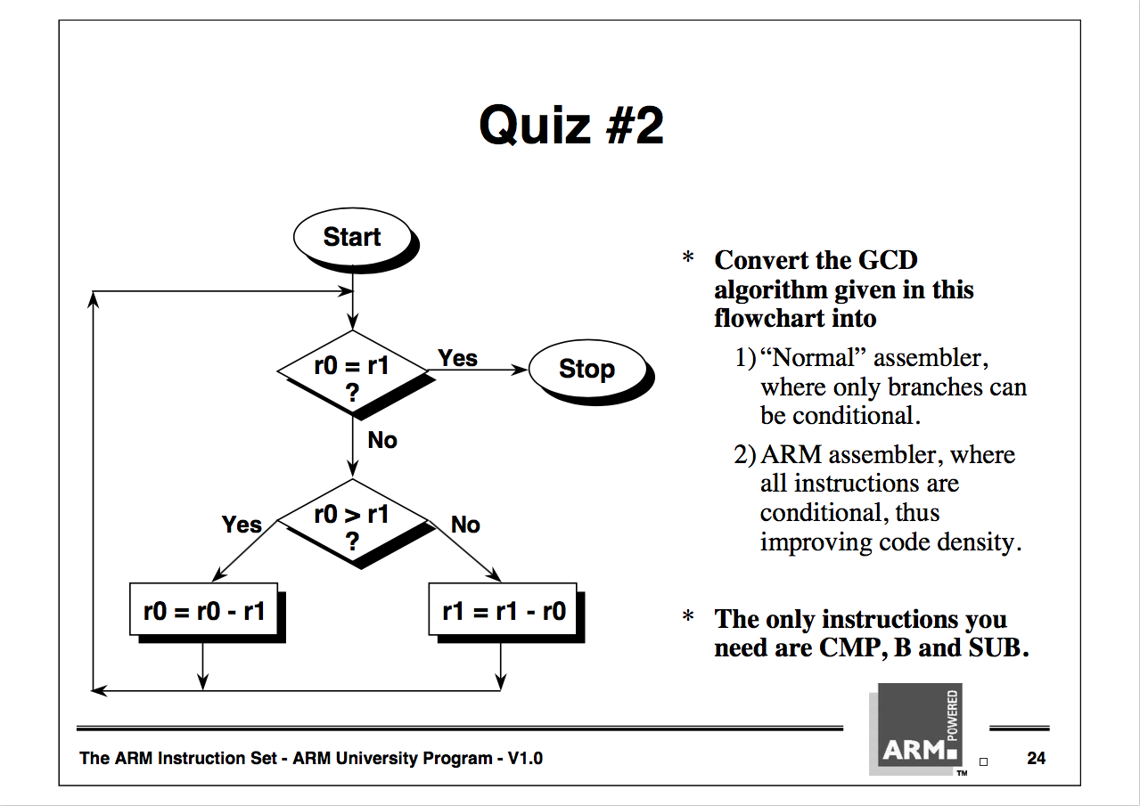
ARM example: GCD algorithm

Slide 46
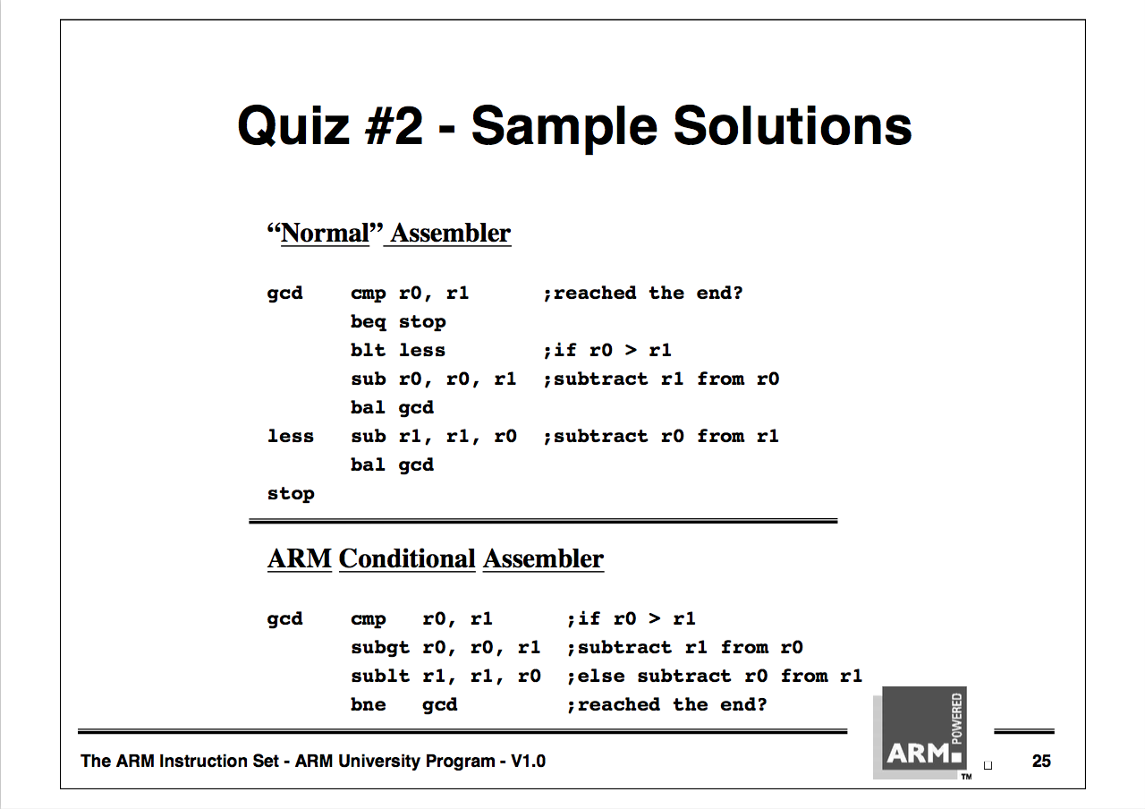
ARM example: GCD assembly

Slide 47
Summary
Each assembly statement corresponds to a single machine language instruction
Most assembly languages follow the same basic structure
Most processors have instructions to call a subroutine and return; argument passing details differ

